Slide 1

Project Title - Network Port Scanner
RAJEEV REDDY GARLAPATI
STU67dafcd979fe11742404825
Siddhartha Institute of Engineering & Technology

Slide 2

PROBLEM STATEMENT
Networks have many “doors” (ports) that allow communication.
Unmonitored open ports can become entry points for attackers.
Organizations often lack visibility into which ports are open and what services are running.
A Port Scanner helps identify these open doors, enabling administrators to secure them and reduce cyber risks.

Slide 3
The Network Port Scanner is a cybersecurity tool designed to identify open ports and the services running on them within a network. By scanning devices, it provides visibility into potential entry points that attackers could exploit. The project aims to help administrators detect vulnerabilities, close unnecessary ports, and strengthen overall network security. This scanner acts as a proactive defense mechanism, ensuring that organizations can monitor their systems, reduce risks, and maintain a secure digital environment.
Project Description

Slide 4

WHO ARE THE END USERS?
System Administrators – to monitor and secure organizational networks.
Cybersecurity Professionals – to detect vulnerabilities and strengthen defenses.
IT Support Teams – to troubleshoot connectivity and service issues.
Students & Researchers – to learn and practice network security concepts.
Small & Medium Businesses – to gain visibility into their network without expensive tools.

Slide 5

Technology Used
Programming Language: Python (for socket programming and automation)
Libraries/Modules:
socket – to establish connections and scan ports
threading – for faster, parallel scanning
argparse – for command-line input handling
Operating System: Works on Windows/Linux
Networking Concepts: TCP/IP protocols, port communication

Slide 6
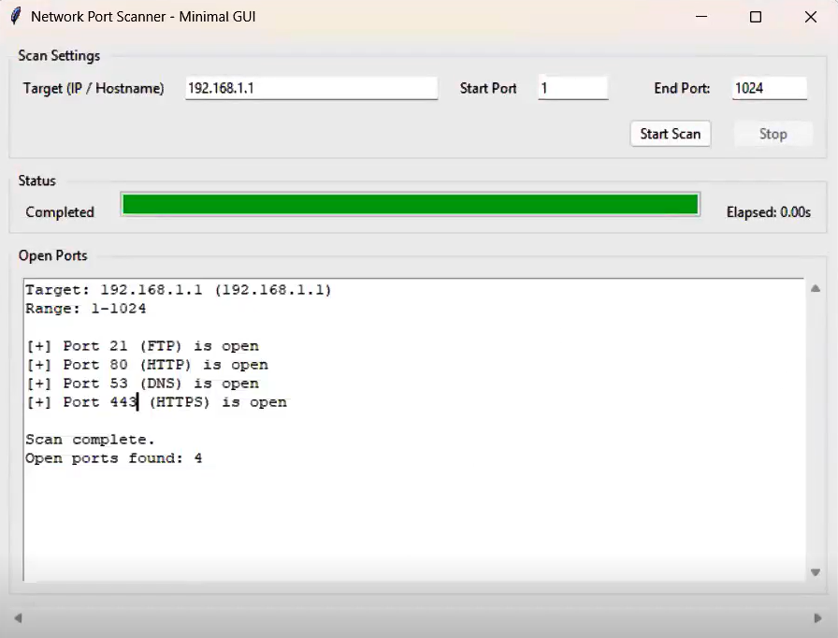
RESULTS
Demo Link

Slide 7
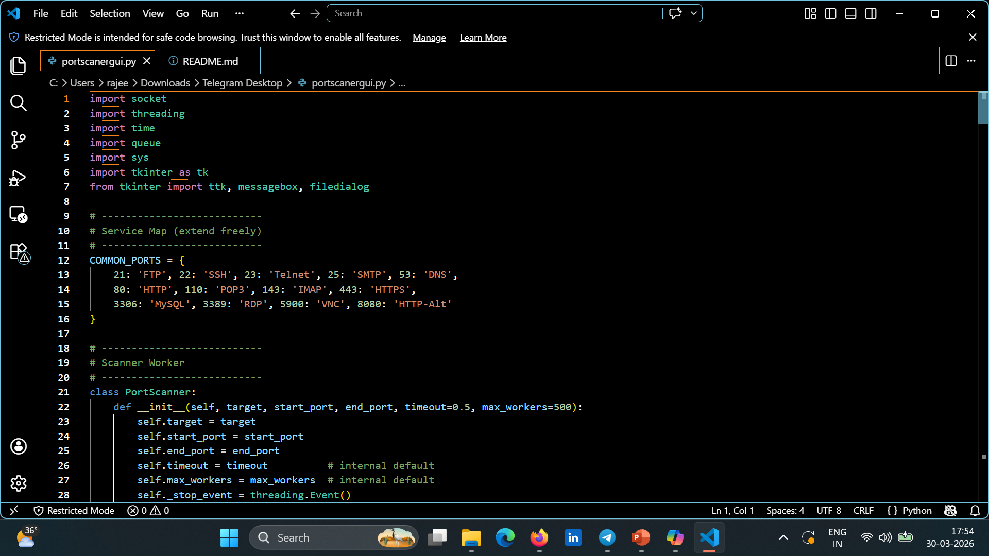
RESULTS
[Add screen shots of your code ]
Demo Link

Slide 8
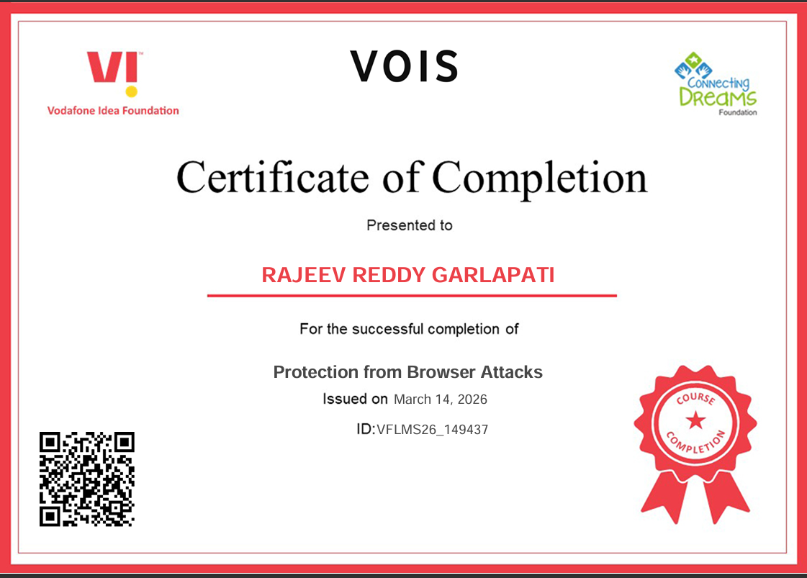
Certificate - Protection from browser attacks

Slide 9

Certificate - Introduction to System Security

Slide 10
GitHub link
https://github.com/Rajeevreddy-git/NetworkScanner.git

Slide 11
Thank you
.
.

